Slide 1

70 East Lake Street Suite 1700 Chicago, IL 60601 www.ctbaonline.org
Gentrification in the City of Chicago
September, 2020

Slide 2
NHS clients’ characteristics
Median annual income of $61,980
$200,000 as the assumed typical home value
$2,000 in annual property taxes for a typical NHS client (1% of home value and less than 4% of annual income )

Slide 3
Longtime Homeowner exemptions Requirements
10 + years as a principal residence and domicile or who, at least 5 continuous years if that person received assistance in the acquisition of the property as part of a government or nonprofit housing program
Household income of $100,000 or less
“Adjusted Homestead Value”: the lesser of the following property’s base homestead value increase
10% increase for each taxable year after the base year for qualified taxpayers with a household income of more than $75,000 but not exceeding $100,000; or
7% increase for each taxable year after the base year for qualified taxpayers with a household income of $75,000 or less¹, or
The property's equalized assessed value (EAV) for the current tax year minus the general homestead deduction, which the latter is the EAV for the current assessment year above the equalized assessed value of the property for 1977 with maximum reduction of $10,000

Slide 4
NB map

Slide 5
Tract and NB (map)

Slide 6
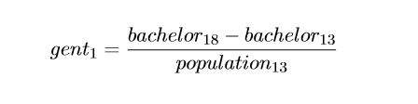
Gentrification definition #1
In order to be considered a “gentriﬁable” tract, household income must be below the median in 2013 ($58,676).
Definition 1: we use Tracts that experienced large positive changes (75th and 90th percentiles) in population aged+25 with a Bachelor Degree or Higher

Slide 7
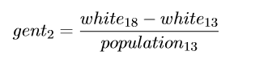
Gentrification definition #2
Definition 2: we use Tracts that experienced large positive changes (75th and 90th percentiles) in white population, excluding Latinos

Slide 8
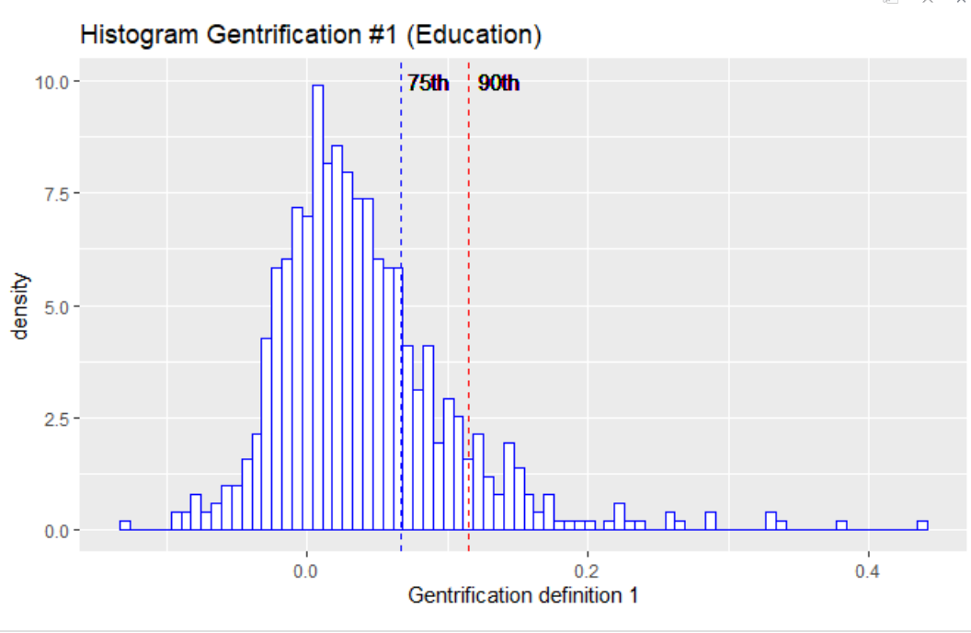
Visual representation of percentile 75th and 90th

Slide 9
MAP of median income by tract (level)

Slide 10
MAP of median home value by tract (level)

Slide 11
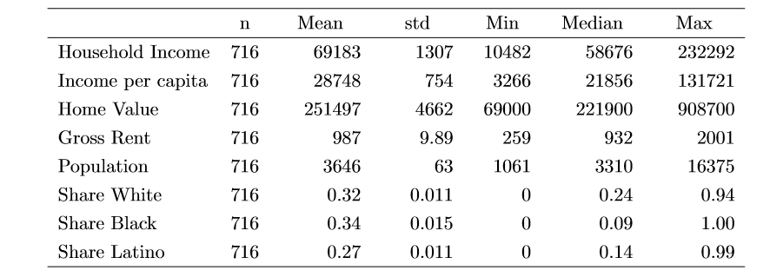
Income, Housing and Population in the City of Chicago by Tracts in 2013

Slide 12
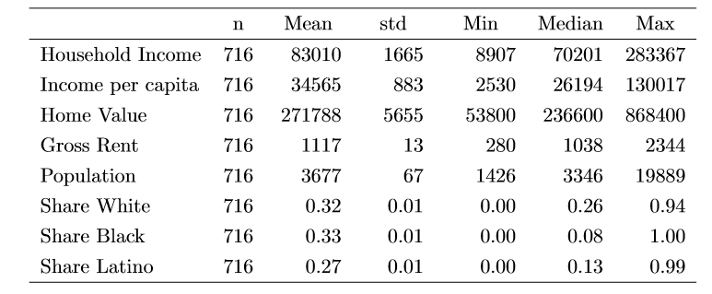
Income, Housing and Population in the City of Chicago by Tracts in 2018

Slide 13
MAP of tracts under gentrification def 1 for 75th and 90th percentile (use colors)

Slide 14
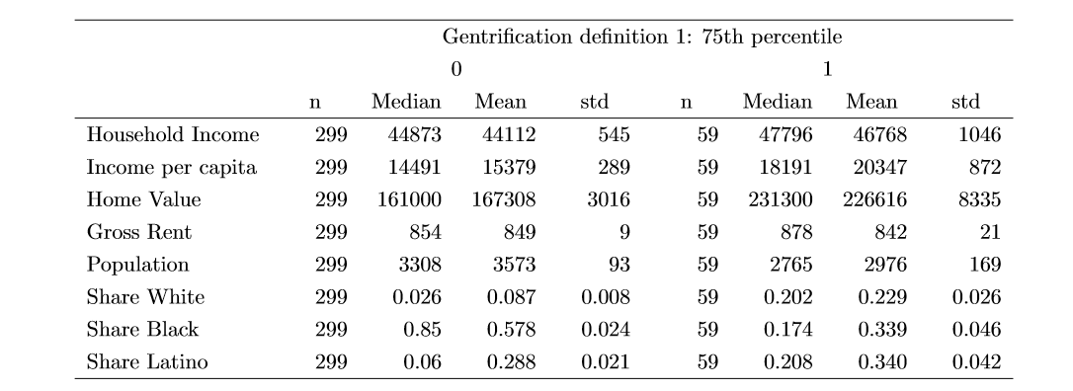
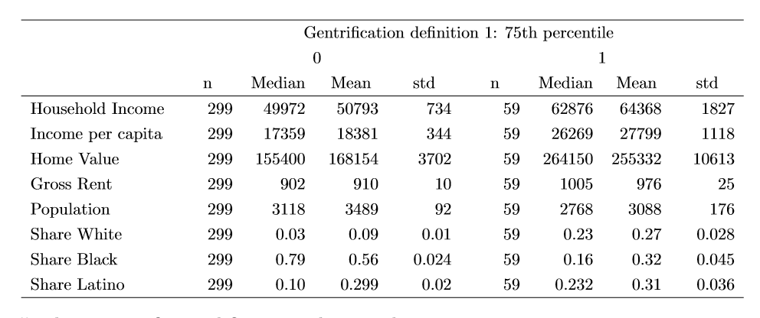
Summary Statistics – Def. #1 (75th per)
2013
2018

Slide 15
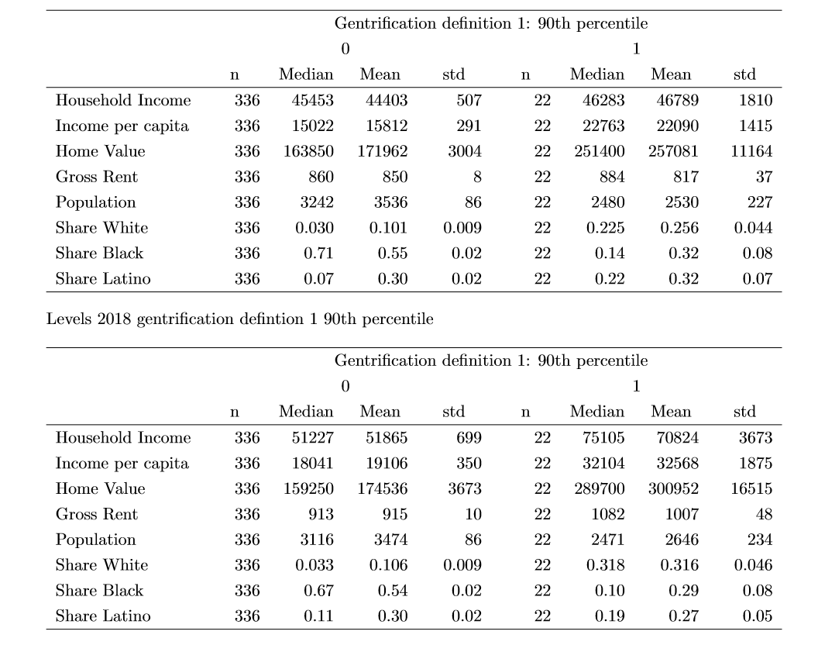
Summary Statistics – Def. #1 (90th per)
2013
2018

Slide 16
MAP of tracts under gentrification def 2 for 75th and 90th percentile (use colors)

Slide 17

Summary Statistics – Def. #2 (75th per)
2013
2018

Slide 18
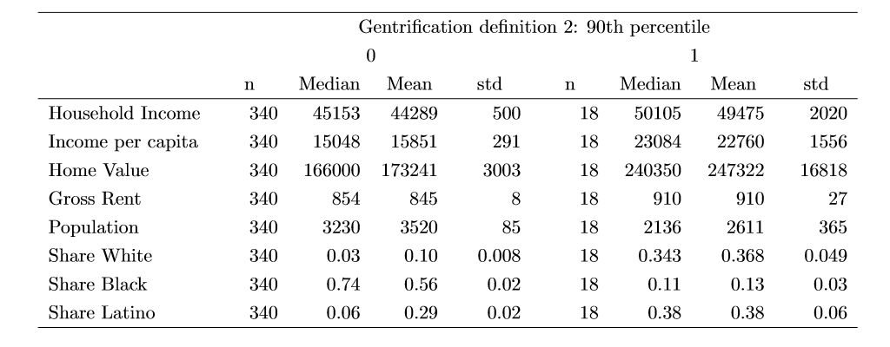
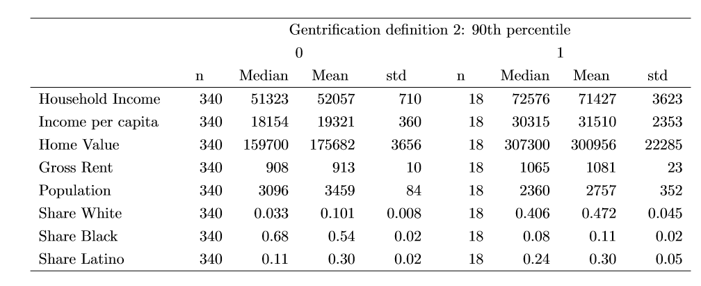
Summary Statistics – Def. #2 (90th per)
2013
2018

Slide 19
Comments on summary statistics for outcome variables in levels
59 and 22 tracts meet definition #1 under the 75th and 90th percentile, respectively
64 and 18 tracts meet definition #2 under the 75th and 90th percentile, respectively
Gentrified tracts are initially less populated
Higher share of Latino population
Higher income and home values
Median and Mean rents are similar

Slide 20
MAP of tracts increase median income under defition #1 at the 75th perc (use colors)

Slide 21
MAP of tracts increase home values under defition #1 at the 75th perc (use colors)

Slide 22
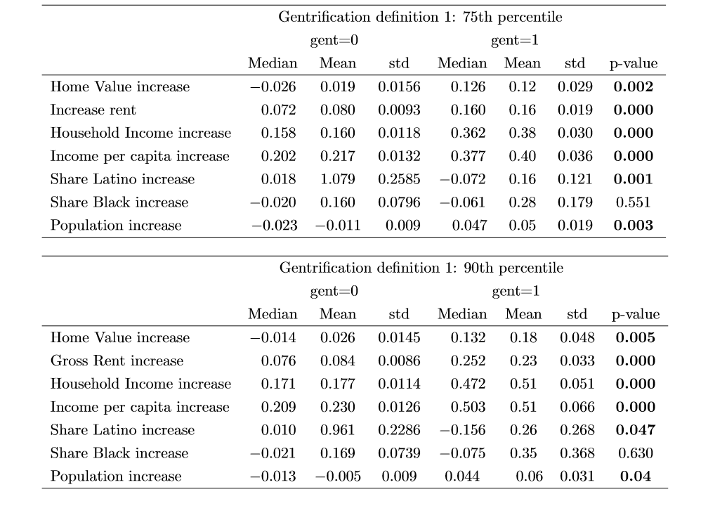
Summary Statistics – Changes – Def. #1

Slide 23
Bullet comments on summary statistics under def #1
Home values, rents, income, and population increase significantly in gentrified tracts
Gentrification occurs mainly in Latino tracts and neighborhoods
Home values increase between 12% and 18%, and rents increase between 16% and 23% in gentrified tracts between 2013 and 2018 in gentrified tracts

Slide 24
MAP of tracts increase median income under defition #2 at the 75th perc (use colors)

Slide 25
MAP of tracts increase home values under defition #2 at the 75th perc (use colors)

Slide 26
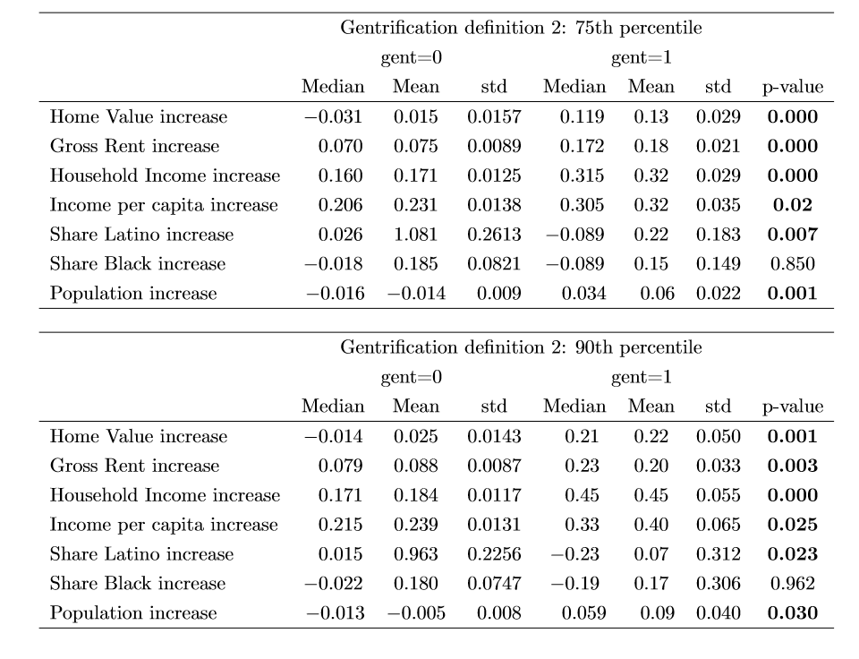
Summary Statistics – Changes – Def. #2

Slide 27
Bullet comments on summary statistics under def #2
Home values, rents, income, and population increase significantly in gentrified tracts according to definition 2
Gentrification locates significantly more in Latino tracts.
Home values increase on average between 13% and 22%, and rents increase between 18% and 20% in gentrified tracts

Slide 28
Recommendations for legislation

Slide 29
For More Information
Drazzel Feliu
Research Director, Center for Tax and Budget Accountability
(312) 332-2151
dfeliu@ctbaonline.org
Fernando Garcia
Research Intern, Center for Tax and Budget Accountability and
MPP Candidate at Harris School of Public Policy
at Roosevelt University
(312) 332-1049
garciaf@uchicago.edu
.
CTBA's principal goal is to ensure major policy systems work to promote social and economic justice. You can help strengthen our efforts by making a tax-deductible donation at www.ctbaonline.org/donate

